Slide 1
Python Dictionaries
An introduction

Slide 2
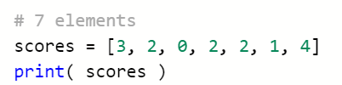

Previously – sequence type - list
Used when you don’t know how many things you need to store
score1, score2, score3, score4 …. ?

Slide 3
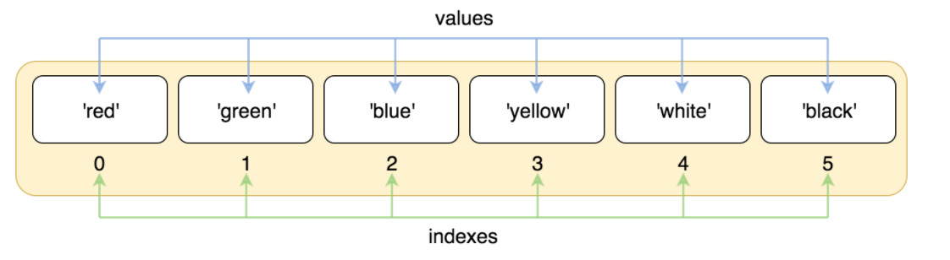

Slide 4
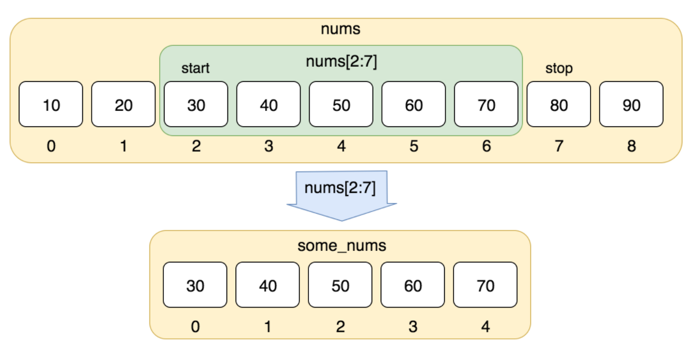

Slide 5
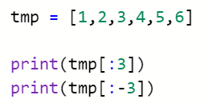

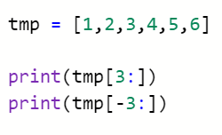

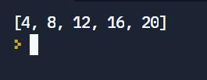

Slices and sub lists:

Slide 6
Today – python Dictionary

Slide 7
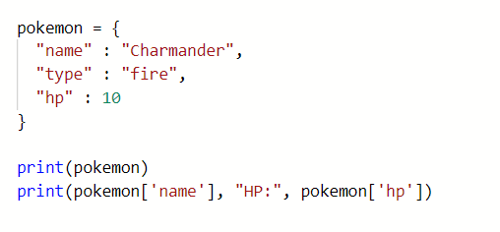


Slide 8
Dictionary
A collection
Unordered
Changeable
Key, value
KEYS
VALUES
name
Charmander
type
fire
hp
10

Slide 9






operations
Access an element x[‘name’]
List all keys x.keys()
List all values x.values()
https://replit.com/@JohnGlazebrook/dictionary-examples

Slide 10
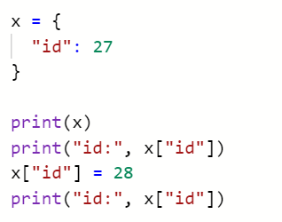

Change an entry x[‘example’] = 100

Slide 11
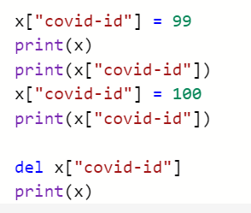
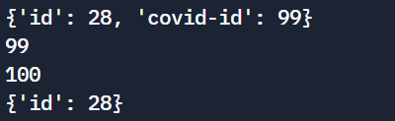
Add an entry x[‘example’] = 99
Change an entry x[‘example’] = 100
Delete an entry del x[‘example’]

Slide 12
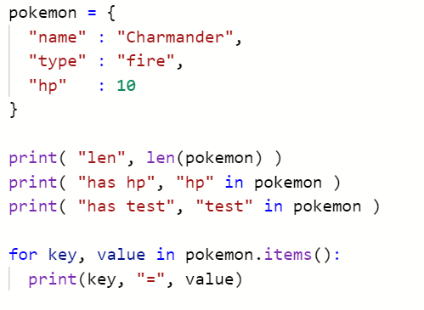
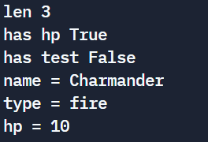
Number of items len(x)
Key exists “example” in x
If statement if “example” in x:
Looping over both for key, value in x.items():

Slide 13
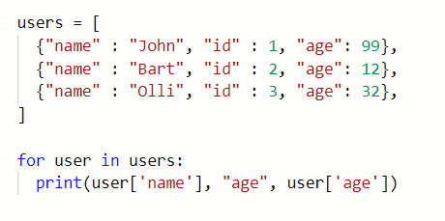

List of dictionaries
For example, users on a gaming platform. We can check their age against a games age rating.

Slide 14
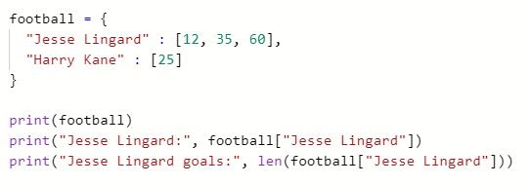


Slide 15
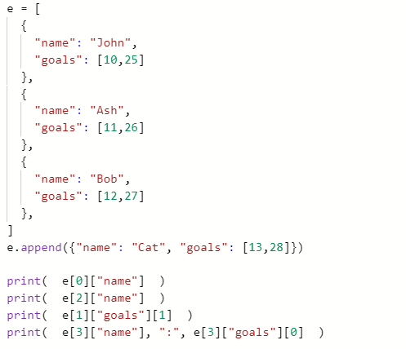
What will be output?

Slide 16

What will be output?

Slide 17
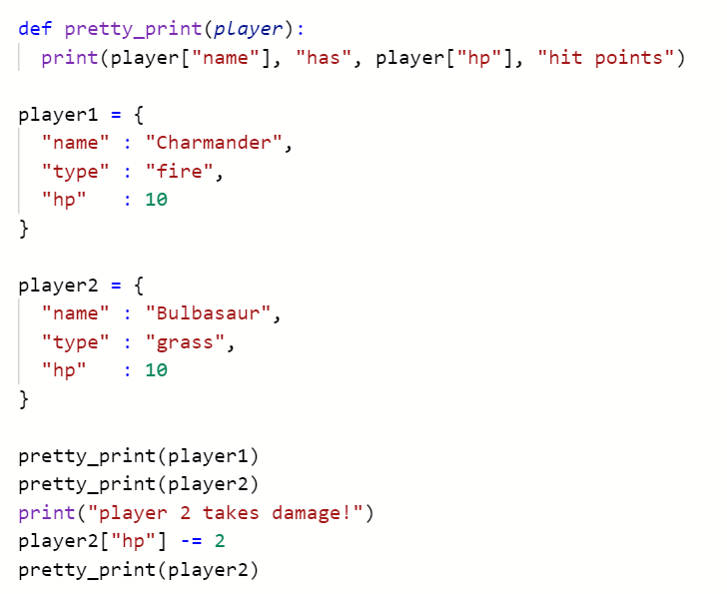
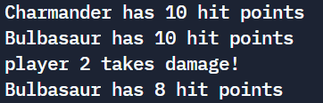

Slide 18
worksheet
There is a worksheet in SharePoint
Don’t forget to keep an eye out for any news articles that cover algorithm errors and algorithm biases. Share! Discuss!

